Slide 1
Ranjeet Commodity Price Prediction

Slide 2
Hybrid Modeling Approach: Combines statistical methods (ARIMA) with deep learning models (RNN-LSTM) to enhance prediction accuracy.
Comprehensive GUI: Offers user-friendly interaction for non-technical users to run predictions and visualize results.
Research-based Development: The project is grounded in research conducted at CDAC-Bangalore and presented at an international conference.

Slide 3
Models:
ARIMA: Used for short-term forecasting (6 days). Utilizes historical data trends and patterns to make predictions.
RNN-LSTM: Applied for long-term forecasting (30 days). Leverages deep learning techniques to handle sequential data and capture temporal dependencies.

Slide 4
Data Management:
Storage: SQL database constructed from CSV files to ensure secure and structured data storage.
Integration: Data pre-processing and storage facilitated through custom Python scripts for seamless database interactions.

Slide 5
Derek Siker Commodity Price Forecasting

Slide 6
Modular Design: Easily customizable pipeline suitable for various commodities and contracts.
Feature Importance: Utilizes feature importance scores to assign weightages to input features, enhancing prediction accuracy.
Comprehensive Data Handling: Handles multiple data sources and formats seamlessly.

Slide 7
Models:
Tree-based Regressors: Predict monthly price direction and median spot price using models like RandomForestRegressor.
Data Integration:
Features from Barchart and Oilworld.
Supports various commodity contracts and averaging methods.

Slide 8
Data Management:
Data Acquisition: Utilizes APIs and data repositories for Barchart and Oilworld data.
Data Processing: Standard data wrangling, pre-processing, and exploratory data analysis.

Slide 9
deadskull7 Agricultural Price Prediction and Visualization on Android App

Slide 10
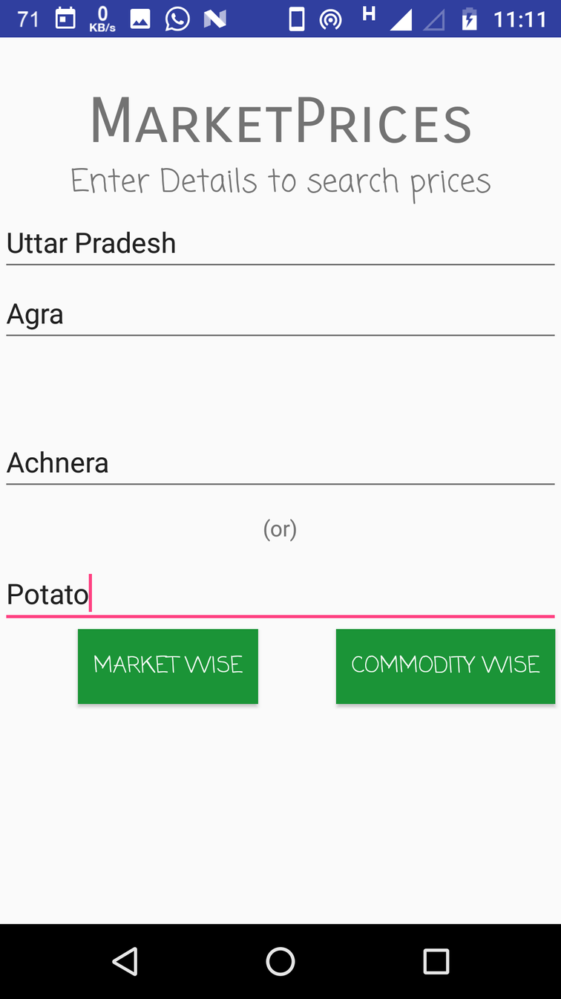
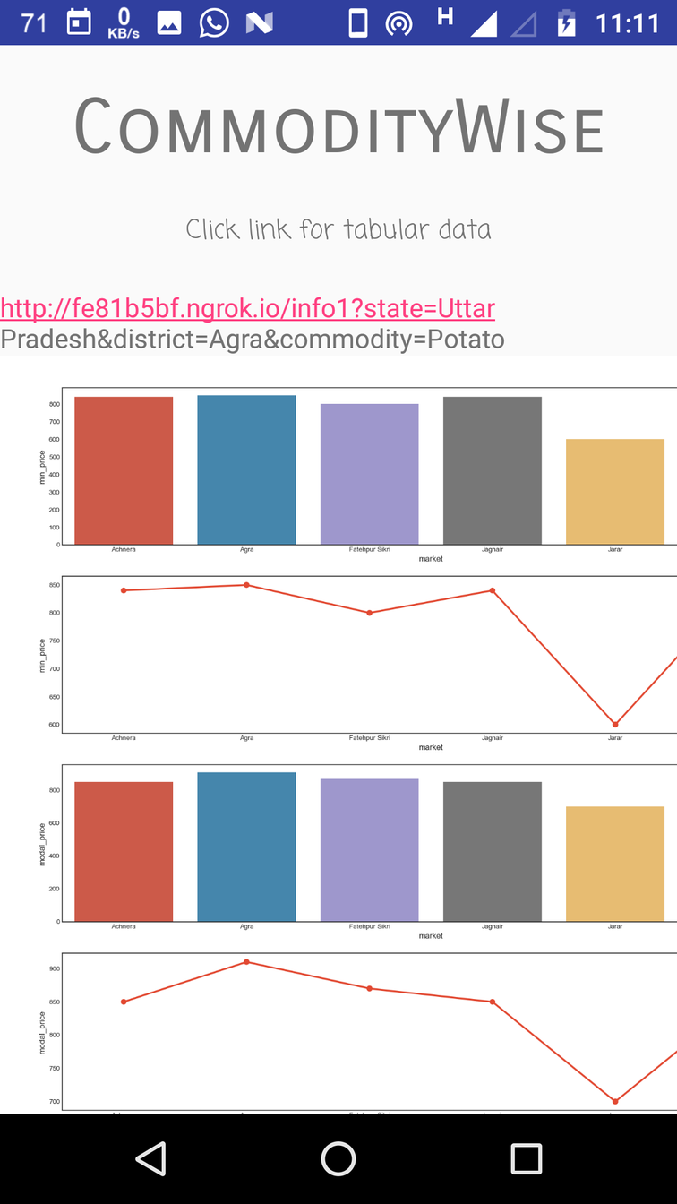
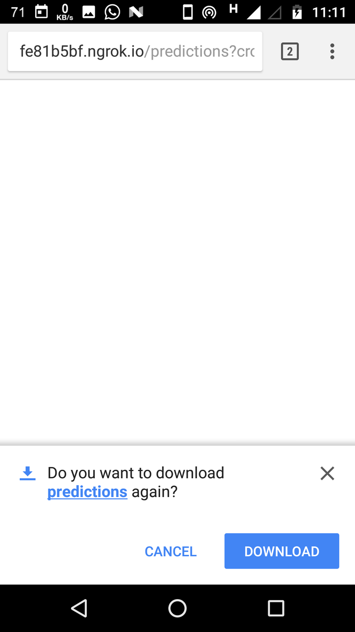

Slide 11
Comprehensive Visualization: Multiple plot types (e.g., pointplot, heat-map, barplot) integrated into the app.
Seamless Integration: Smooth connection between machine learning outputs and the Android interface.
User Accessibility: Features for both regular and wholesale buyers to analyze market trends.

Slide 12
Prediction Models:
Regression techniques on time series data for forecasting wholesale prices.

Slide 13
Data Management:
Data Source: Daily updated market prices from data.gov.in.
Data Visualization: Graphical representation of market-wise and commodity-wise prices.
Data Export: Option to download data in CSV format for detailed analysis.

